Slide 1
Advanced Modeling for Distribution Planning with OpenDSS
Instructor
Roger C. Dugan Sr. Technical Executive Sacramento, California June 22-23, 2017

Slide 2

Instructor
Roger C. Dugan, Life Fellow, IEEE
Roger is a Sr. Technical Executive with EPRI in Knoxville, Tennessee USA. He has over 45 years of combined experience in distribution engineering with EPRI, Electrotek Concepts, and Cooper Power Systems. He holds the BSEE degree from Ohio University and the Master of Engineering in Electric Power Engineering degree from Rensselaer Polytechnic Institute, Troy, NY. Roger has worked on many diverse aspects of power engineering over his career because of his interests in applying computer methods to power system simulation. Beginning with a student internship with Columbus and Southern Ohio Electric Co, his work has been focused on Distribution Engineering. He was elected a Fellow of the IEEE for his contributions in harmonics and transients analysis. Recently, he has been very active in distributed generation, particularly as it applies to utility distribution systems and distribution system analysis. He was the 2005 recipient of the IEEE Excellence in Distribution Engineering Award. He is coauthor of Electrical Power Systems Quality published by McGraw-Hill, now in its 3rd edition. He serves on the IEEE PES Distribution System Analysis Subcommittee and is active in the Distribution Test Feeders WG.

Slide 3
Basic Usage
Installation and basic principles

Slide 4
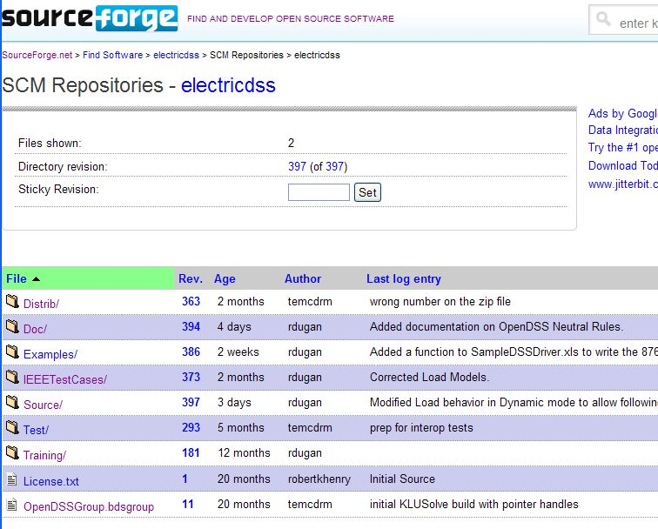
Repository on SourceForge.Net

Slide 5
Accessing the SourceForge.Net Source Code Repository with TortoiseSVN
Install a TortoiseSVN client from Tortoisesvn.net/downloads.
Recommendation:
Then, to grab the files from SourceForge by: 1 - create a clean directory such as "c:\opendss" 2 - right-click on it and choose "SVN Checkout..." from the menu 3 - the repository URL is
http://electricdss.svn.sourceforge.net/svnroot/electricdss
(Change the checkout directory if it points somewhere other than what you want.)
Thereafter, to update a folder or file, right-click on the folder or file and select SVN Update

Slide 6
Program Installation

Slide 7
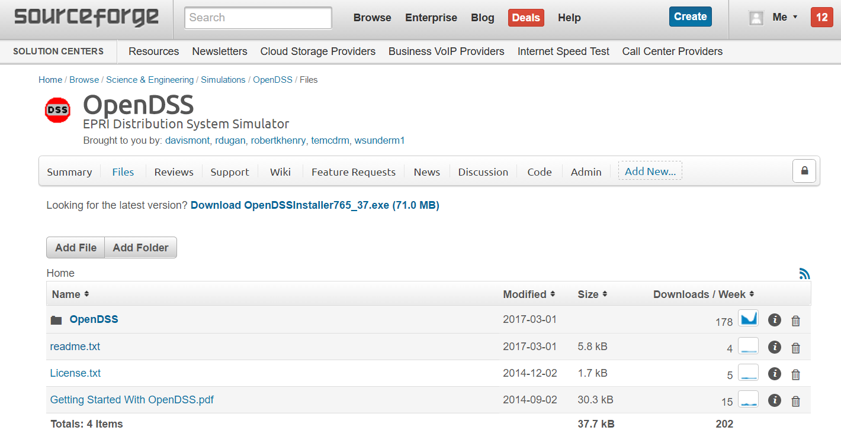
Download the Installer Files

Slide 8
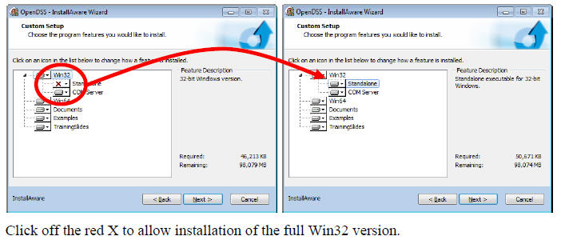
Install Both 32-bit and 64-bit Versions of OpenDSS
DG Screener and Excel typically use 32-bit OpenDSS, but both versions must be installed to get 32-bit server fully installed. Windows will figure out which one needs to be executed. Magic!!

Slide 9
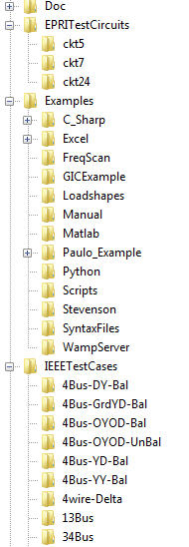
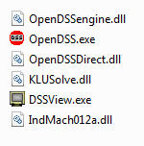
OpenDSS Files Installed
Main Program Files

Slide 10
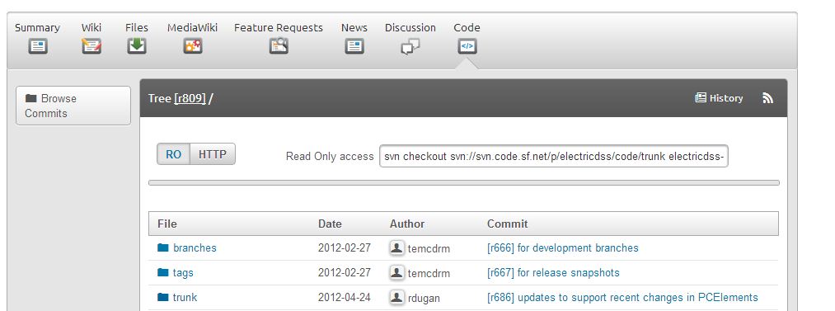
SourceForge.Net Links for OpenDSS
EPRI Links Page
http://smartgrid.epri.com/SimulationTool.aspx
OpenDSS Download Files:
http://sourceforge.net/projects/electricdss/files/
Top level of Main Repository

Slide 11
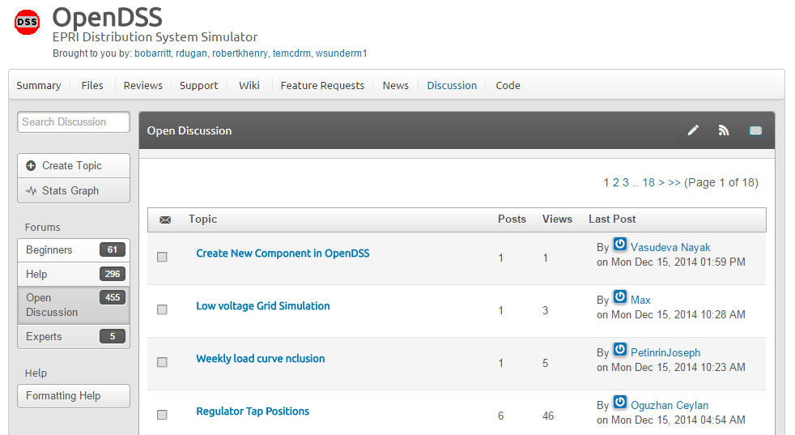
Discussion Forum & News for OpenDSS

Slide 12
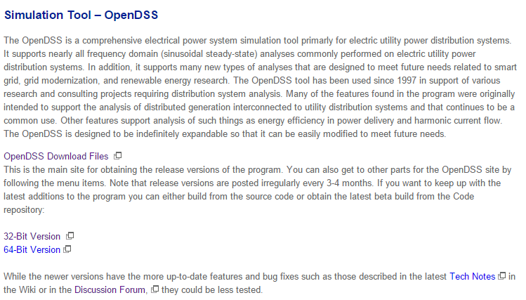
EPRI OpenDSS Link Page
http://smartgrid.epri.com/SimulationTool.aspx

Slide 13
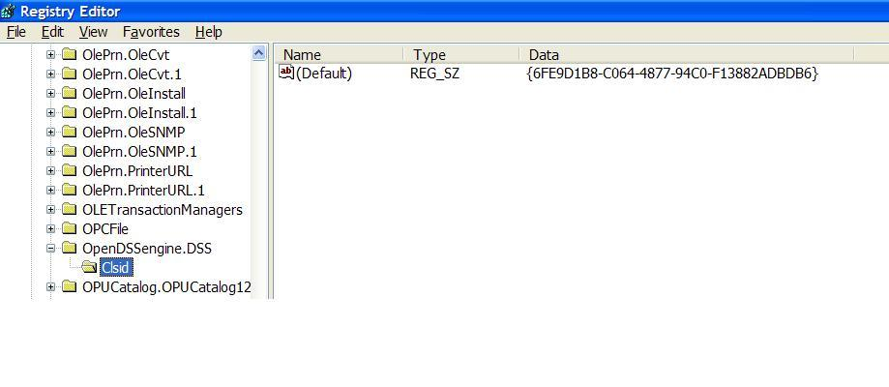
COM Server Registration
Windows Registry Entry
GUID
The Server shows up as “OpenDSSEngine.DSS” in the Windows Registry
The OpenDSS is now available to any program on the computer

Slide 14
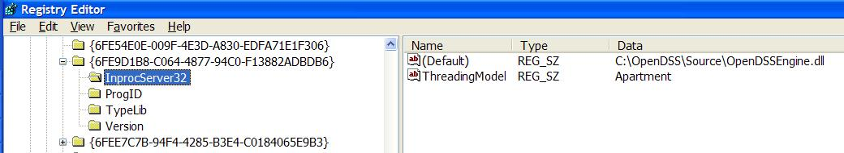
The GUID References the DLL File ….
If you look up the GUID in RegEdit
Points to OpenDSSEngine.DLL (In-process server, Apartment Threading model)

Slide 15
Starting the Program
.

Slide 16
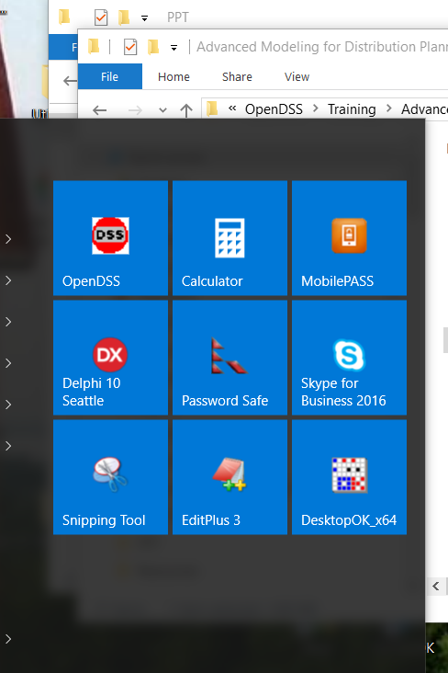
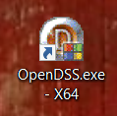
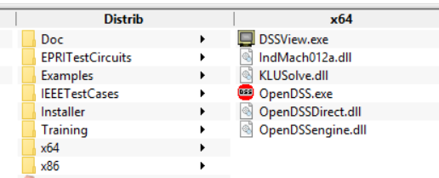
Starting OpenDSS.exe – Standalone executable
Start Menu
Desktop Icon
File Manager/Explorer

Slide 17
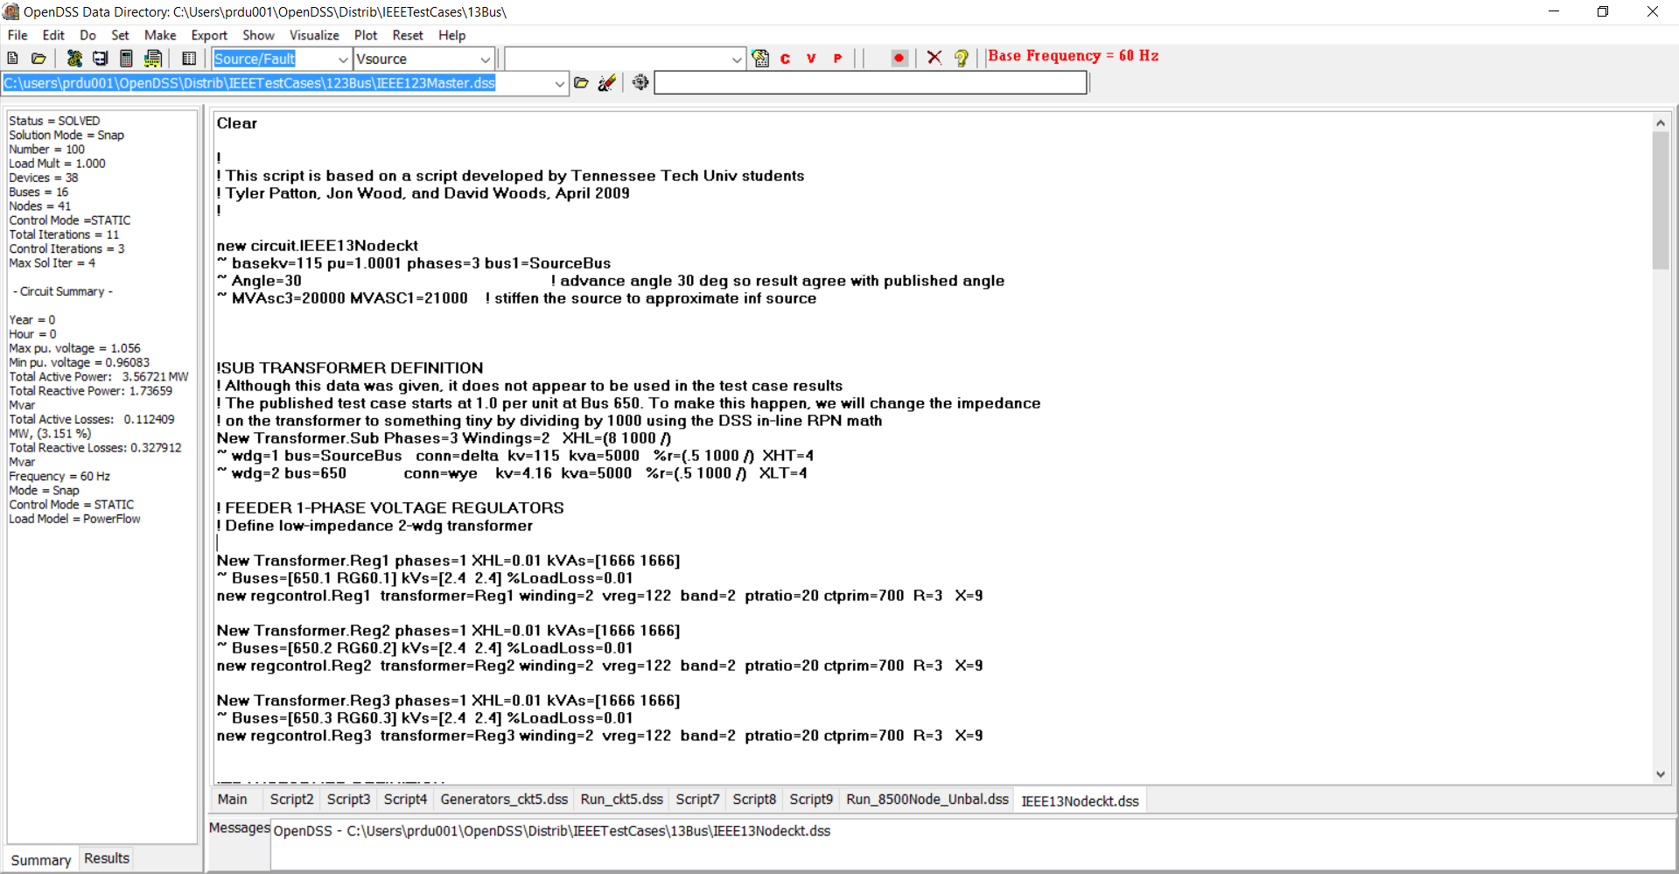
Basic User Screen
Home Folder
Circuit Script
Solution Summary
File Displayed

Slide 18
(Live Demo)
.

